Slide 1
Crew AI

Slide 2
Crew AI
CrewAI is a cutting-edge Python framework for orchestrating role-playing, autonomous AI agents.
By fostering collaborative intelligence, CrewAI empowers agents to work together seamlessly, tackling complex tasks.

Slide 3
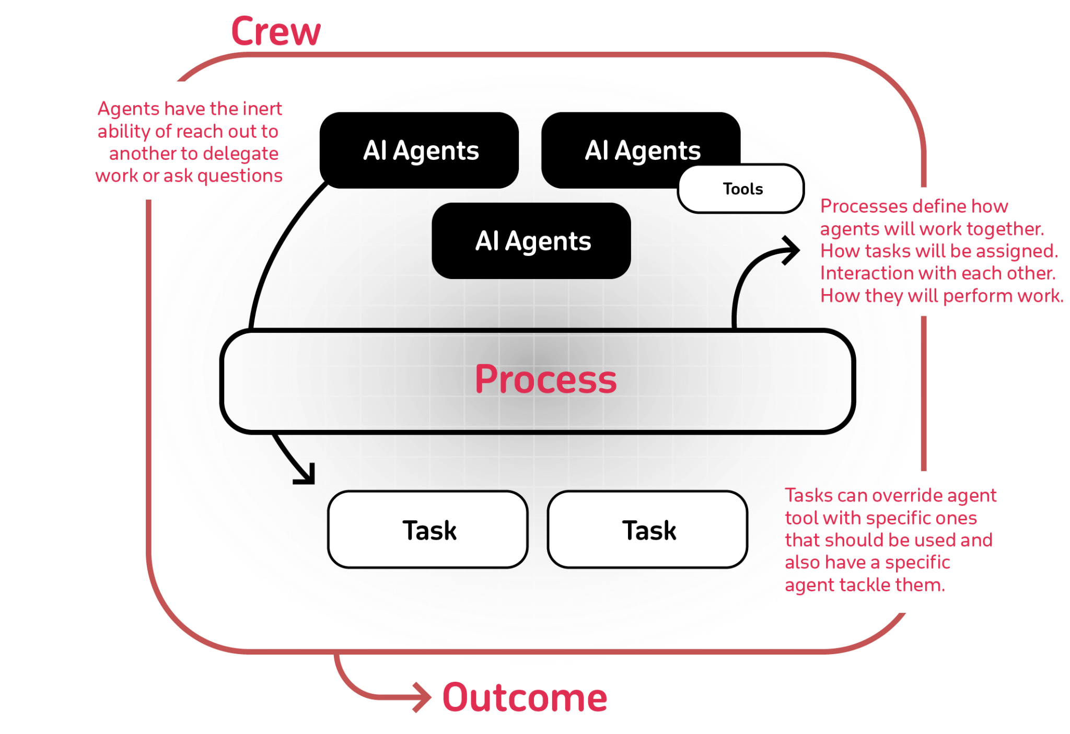

Slide 4
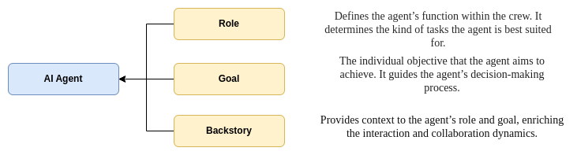
Major Building Blocks
Agents
An agent is an autonomous unit programmed to
Perform tasks
Make decisions
Communicate with other agents

Slide 5
Example
writer_agent:
role: >
Job Description Writer
goal: >
Use insights from the Research Analyst to create a detailed,
engaging, and enticing job posting.
backstory: >
Skilled in crafting compelling job descriptions that resonate
with the company's values and attract the right candidates.

Slide 6
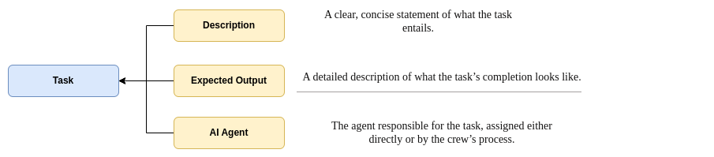
Major Building Blocks
Task
Detailed guide on managing and creating tasks within the CrewAI framework, reflecting the latest codebase updates.

Slide 7
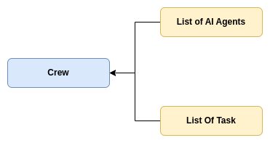
Major Building Blocks
Crew
A crew in crewAI represents a collaborative group of agents working together to achieve a set of tasks. Each crew defines the strategy for task execution, agent collaboration, and the overall workflow.

Slide 8
Major Building Blocks
Tools
A tool in CrewAI is a skill or function that agents can utilize to perform various actions.
Interface of AI Agents to the external world
CrewAI Toolkit
LangChain Tools

